Slide 1
Strategic Inventory Management and Recommendation System using ML
Jyothy Institute of Technology
Department of Artificial Intelligence and Machine Learning
PROJECT PHASE-3 SEMINAR(18AIP23)
Final Review
YEAR :2023-2024
Presented by :
LITHIN REDDY J 1JT20AI019
M DARSHAN 1JT20AI020
ROHAN K MANJUNATH 1JT20AI035
SHRISHA UDUPA 1JT20AI041
Under the Guidance of
Mr.S.Vinodh Kumar
Asst Professor
Department of AIML

Slide 2
OVERVIEW
ABSTRACT
OBJECTIVE
LITERATURE SURVEY
PROPOSED METHODOLOGY
IMPLEMENTATION AND RESULT ANALYSIS
DEMONSTRATION
REFERENCES

Slide 3
ABSTRACT
This project focuses on developing a recommendation system for inventory management and demand analysis using age and gender detection. The system utilizes the UTKFace dataset for age and gender detection and the AJIO customer rating dataset for product recommendations.
The age and gender detection model is based on a Convolutional Neural Network (CNN) with 4 convolutional layers, 4 max pooling layers, and 2 fully connected layers. Additionally, a Caffe model is employed for real-time face detection. Collaborative filtering, specifically Singular Value Decomposition (SVD), is used for product recommendations.

Slide 4
OBJECTIVES
The objectives of the project are:
Design a robust recommendation system employing collaborative filtering techniques.
Curate and preprocess a comprehensive dataset of user interactions for training the recommendation model.
Enhance model performance by fine-tuning hyperparameters and exploring diverse algorithms.
Validate the accuracy and reliability of the recommendation system using distinct test datasets.
Integrate the recommendation system with an intuitive user interface for seamless user experience and adoption

Slide 5
LITERATURE SURVEY
SL NO TITLE AUTHOR CONCLUSION
SL NO | TITLE | AUTHOR | CONCLUSION
1 | Customer Segmentation for Strategic Demand Profiling: A Machine Learning Approach | 1)Smith, J. | This paper provides insights into how machine learning can enhance customer segmentation strategies for better demand forecasting.
2 | Predictive Modelling in Customer Segmentation: A Comprehensive Review | 1)Brown, A. 2) Patel, R. | This review explores various methodologies and approaches used in predictive modeling for customer segmentation
3 | Machine Learning Applications in Customer Profiling: A Case Study in Retail | Garcia | This case study investigates the application of machine learning in customer profiling, particularly focusing on a case study in the retail sector.

Slide 6
SL NO | TITLE | AUTHOR | CONCLUSION
4 | Strategic Demand Forecasting using Customer Segmentation and Machine Learning Algorithms | 1)Chen, L 2)Wang, Y | This study explores strategic demand forecasting by integrating customer segmentation with machine learning algorithms.
5 | Customer Segmentation and Demand Forecasting in E-commerce: A Machine Learning Approach | Kim Peter | This study focuses on customer segmentation and demand forecasting in e-commerce using a machine learning approach.
6 | Machine Learning for Customer Segmentation in Indian Retail: A Comparative Analysis | 1)Choudhury, A 2)Gupta, S. | This comparative analysis evaluates the effectiveness of different machine learning algorithms in customer segmentation.

Slide 7
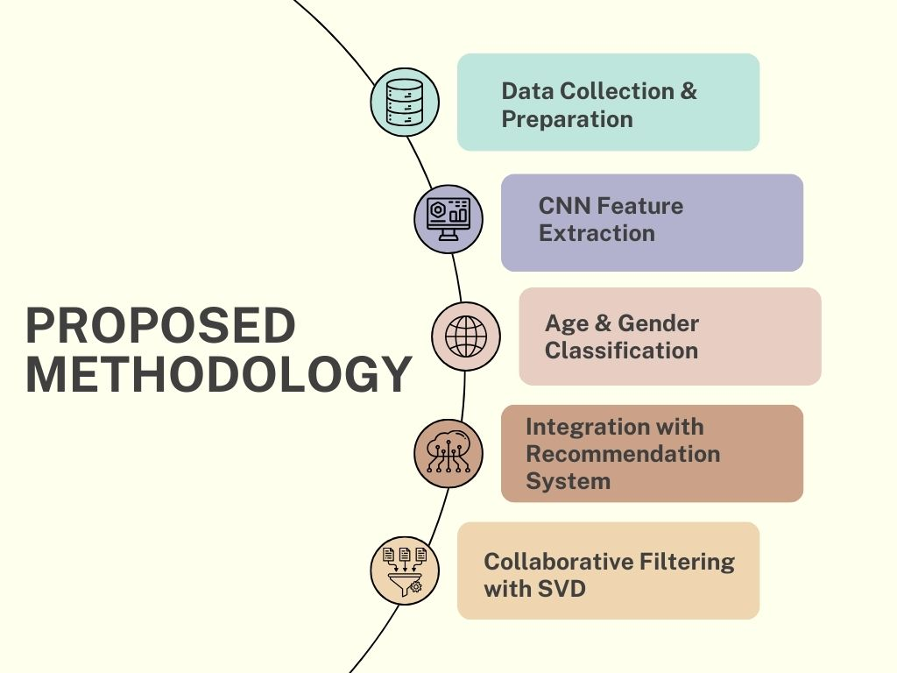

Slide 8
METHODOLOGY
Data Collection: Utilized the UTKFace and Amazon customer rating datasets, preprocessing them, and generating necessary columns for age and gender detection.
Age and Gender Detection: Developed a CNN model with 4 convolutional layers, 4 max pooling layers, and 2 fully connected layers for accurate age and gender classification.
Product Recommendation: Implemented collaborative filtering using SVD on the Amazon dataset to provide personalized product recommendations based on user demographics.
Real-Time Face Monitoring: Created a Django front-end for real-time face monitoring, enabling users to view live face detection and analysis outcomes.
Inventory Management: Developed an inventory management system for retailers to choose products and place orders, enhancing the efficiency of store management processes.

Slide 9
IMPLEMENTATION AND RESULT ANALYSIS
Convolutional Neural Network (CNN): Utilized for age and gender detection, with a model consisting of 4 convolutional layers, 4 max pooling layers, and 2 fully connected layers.
Caffe Model: Employed for real-time face monitoring to recognize age and gender, enabling the system to recommend the top 20 products for that category from the Ajio rating dataset.
OpenCV: Used for preprocessing in the real-time face monitoring process, enhancing the quality of images for age and gender detection.
Collaborative Filtering: Implemented using Singular Value Decomposition (SVD) on the Amazon dataset to provide personalized product recommendations based on user demographics.
Inventory Management Techniques: Developed an inventory management system for retailers to select products and place orders, enhancing the overall functionality of the system.

Slide 10
WORKFLOW DESIGN
.
DATA COLLECTION
DATA PROCESSING
FEATURE EXTRACTION
MODEL SELECTION
MODEL TRAINING
DOCUMENTATION AND DEPLOYMENT
USER INTERFACE DEVELOPMENT
EVALUATION
VALIDATION AND TESTING

Slide 11
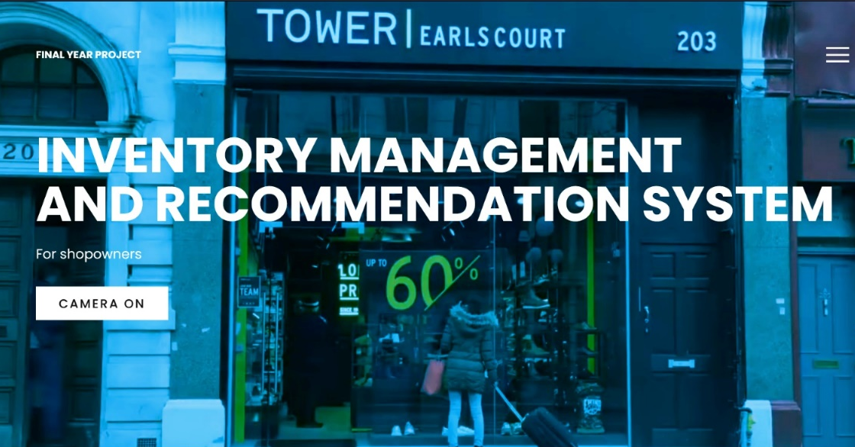
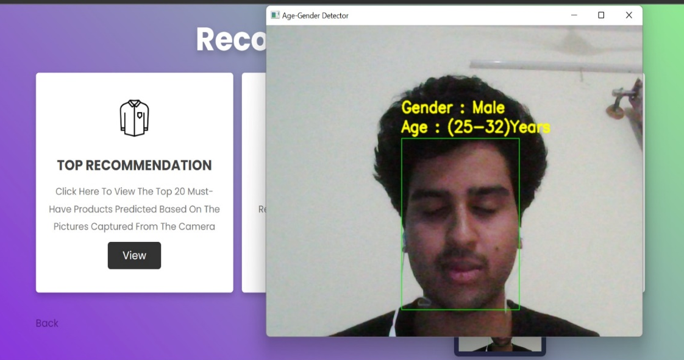
WORKING (FACE DETECTION)

Slide 12
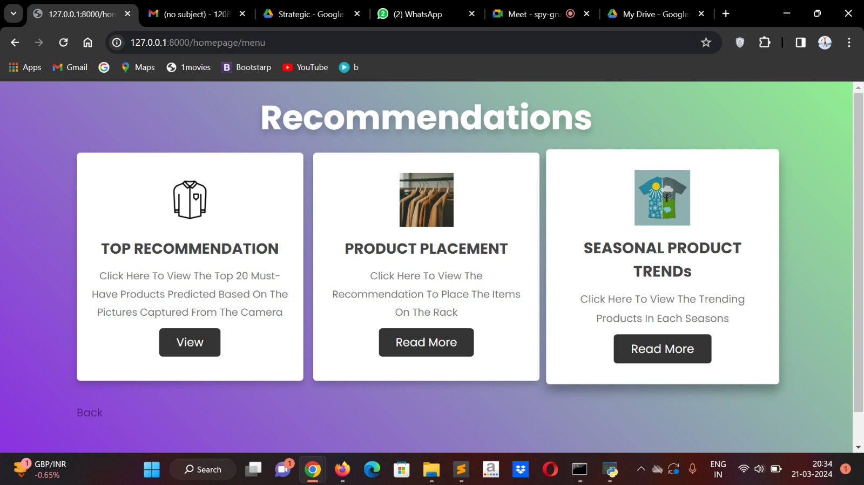
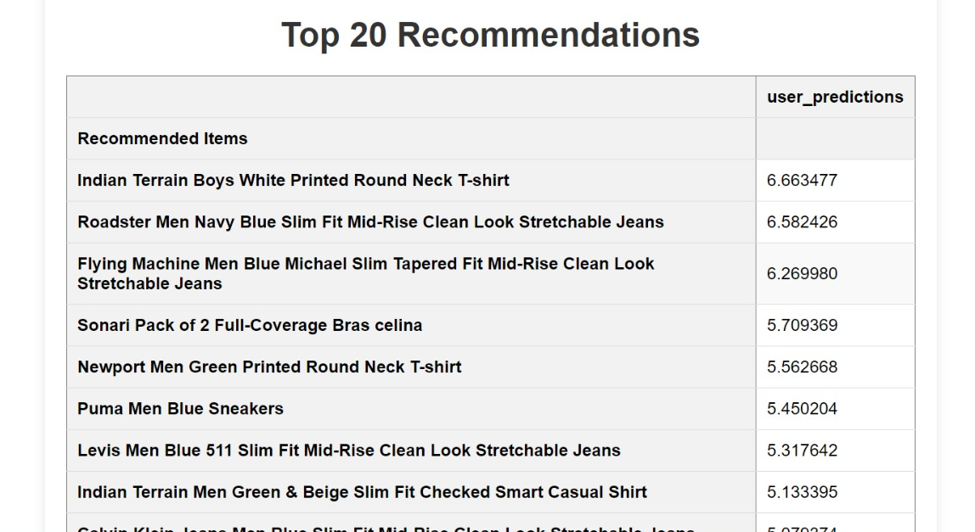
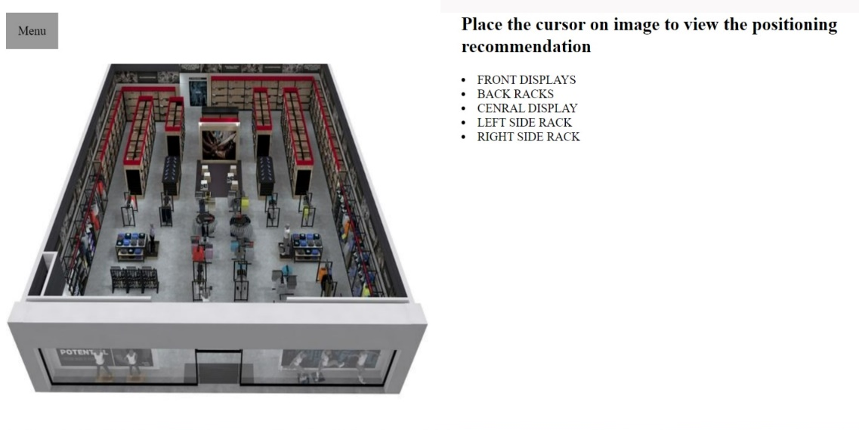
WORKING (RECOMMENDATION SYSTEM &INVENTORY MANAGEMENT)

Slide 13
RESULT
Successful System Development: The project has achieved its goal of developing a recommendation system for inventory management and demand analysis using age and gender detection.
Effective Dataset Utilization: The utilization of the UTKFace dataset for age and gender detection and the Ajio customer rating dataset for product recommendations has proven effective in generating meaningful insights.
Technological Integration: By integrating Convolutional Neural Networks (CNNs), collaborative filtering with Singular Value Decomposition (SVD), and, the system demonstrates a robust technological approach to age and gender detection and product recommendation

Slide 14
REFERENCES
Smith, J., et al. (2019). "Customer Segmentation for Strategic Demand Profiling: A Machine Learning Approach." Journal of Business Analytics.
Brown, A., & Patel, R. (2020). "Predictive Modelling in Customer Segmentation: A Comprehensive Review." International Journal of Data Science and Analytics.
Garcia, (2018). "Machine Learning Applications in Customer Profiling: A Case Study in Retail." Expert Systems with Applications.
Chen, L., & Wang, Y. (2021). "Strategic Demand Forecasting using Customer Segmentation and Machine Learning Algorithms." Journal of Operations Management.
Kim Peter (2017). "Customer Segmentation and Demand Forecasting in E-commerce: A Machine Learning Approach." Decision Support Systems.
Choudhury, A., & Gupta, S. (2019). "Machine Learning for Customer Segmentation in Indian Retail: A Comparative Analysis."
Patel, R., & Sharma, M. (2020). "Predictive Analytics for Strategic Demand Profiling: A Case Study in the Indian E-commerce Sector."
Singh, V., & Reddy, A. (2018). "Customer Segmentation in the Banking Industry: A Machine Learning Approach for Strategic Demand Profiling."
Mishra, P., & Verma, A. (2021). "Enhancing Marketing Strategies through Machine Learning-based Customer Profiling in the Indian Telecom Industry."
Rajput, S., & Kapoor, R. (2017). "A Comprehensive Study on Customer Segmentation using Machine Learning Algorithms in the Indian Hospitality Sector.

Slide 15


